Slide 1


WAFT Review
Wearable and Flexible Technologies
Enabled by Advanced Thin-Film Manufacture and Metrology
Begbroke Science Park, Oxford
Feb-06-2019

Slide 2

















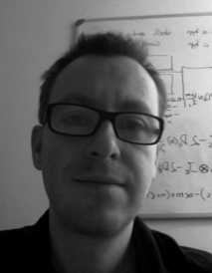
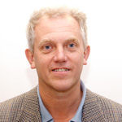
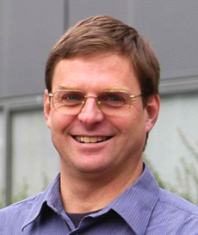
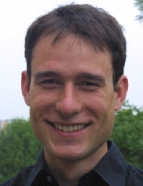
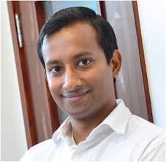
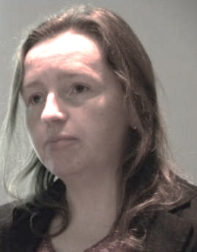
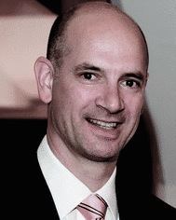
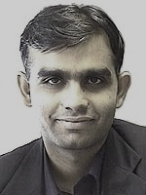



Who we are
Highly innovative project aiming to take our world-leadership in devices of advanced functional materials into the ~77 Billion/Year Wearables Market.
World-leading consortium
Principal Investigator
Gino Hrkac
C David Wright
Dan Hewak
Moritz Riede
Harish
Bhaskaran
Hazel Assender
Martin Castell
Bhaskar Choubey
Many opportunities to influence cognate areas
Centre for Applied Superconductivity, Southampton ORC, Exeter Additive Layer Manufacturing, Oxford Begbroke Innovation Park, PI’s Manufacturing Fellowship (includes IBM and the Microelectronics iNets).
High National Importance: Foresight Future of Manufacturing Report highlights the need to study pathways to scale-up such Advanced Materials-based manufacturing of components and systems.

Slide 3
Upscaling focus
Exciting science
Project official start-date: 1st May 2015
Project partners well integrated
Recruitment of PDRAs
2018-19
2016-18
Research efforts well underway
2016-17
2015-16

Slide 4
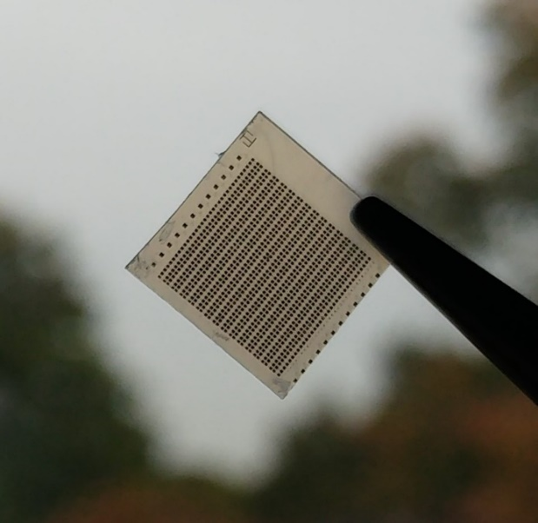
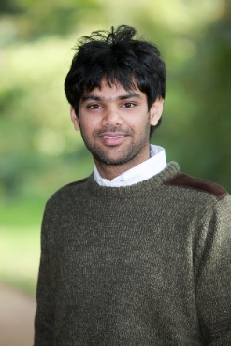
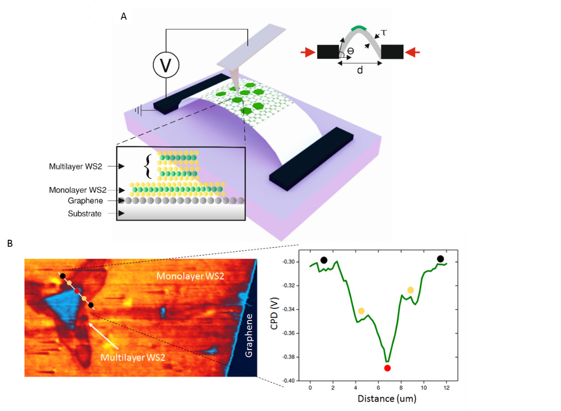
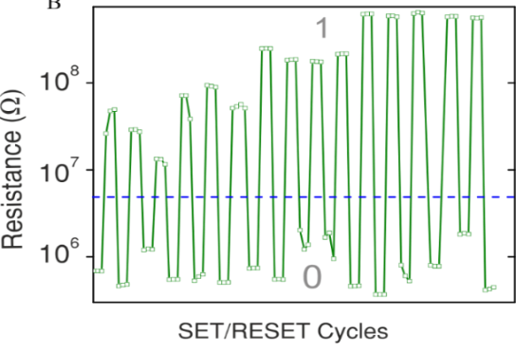
Flexible Phase Change Memories
Stress & Strain Metrology at the Nanoscale
Syed Ghazi
Syed Ghazi Sarwat et al. Nanoletters 17, (2017)
Syed Ghazi et al. Nanoletters, 18 2018

Slide 5
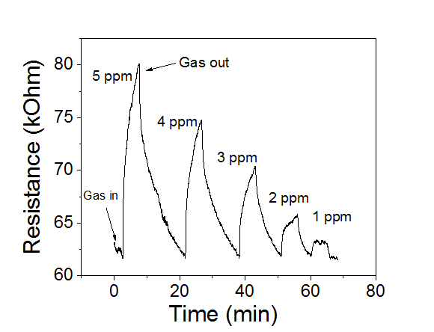
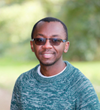
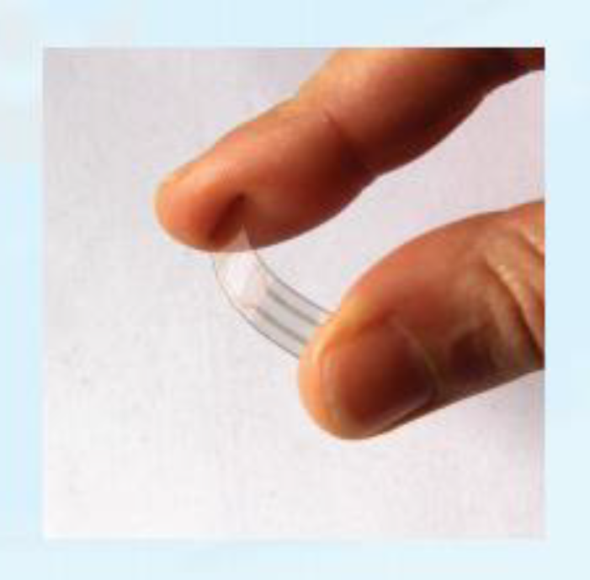
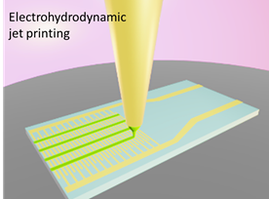
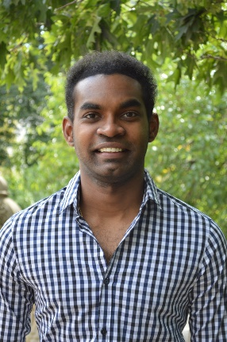
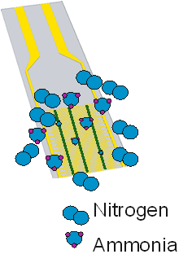
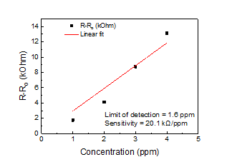
Flexible Chemresistor Sensors
Printed conducting polymer based chemiresistors approach detection of 1.6 ppm for ammonia gas.
Nipho Mkhize (Bhaskaran Group) & Krish Murugappan (Castell Group)

Slide 6
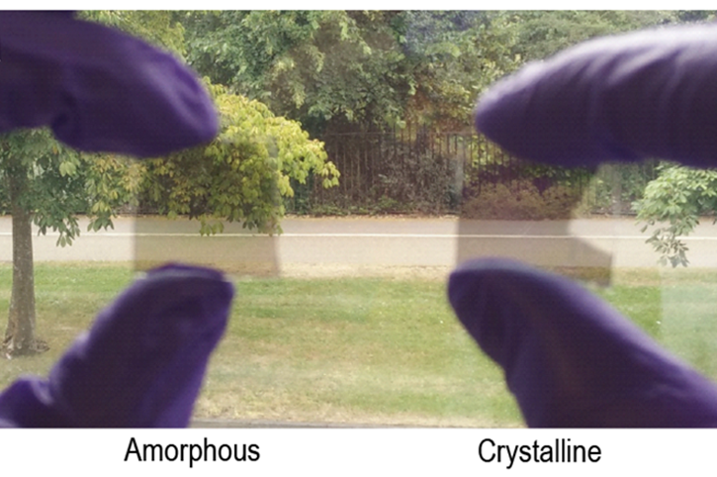
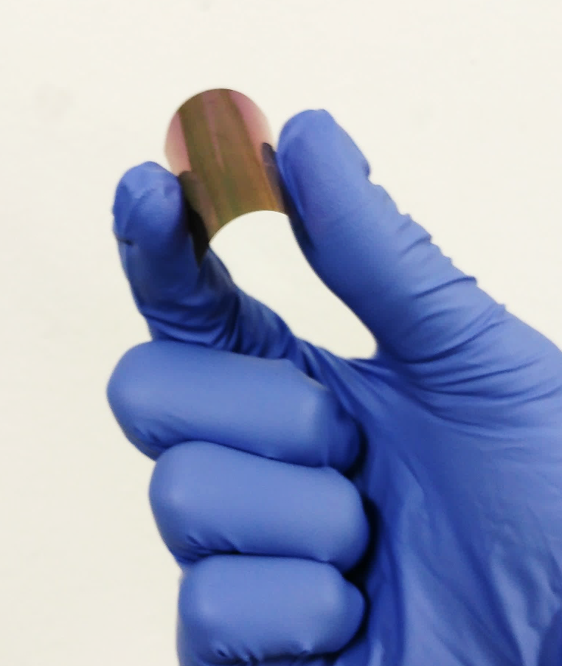
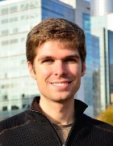
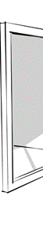


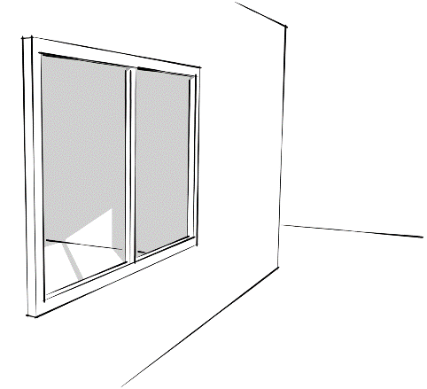
Bistable Smart Glazing
Smart glazing only 250 nm total thickness
Amorphous
(low infrared transfer)
Crystalline
(high infrared transfer)
Compatible with curved and flexible glass
Nathan Youngblood
Summer
Winter

Slide 7

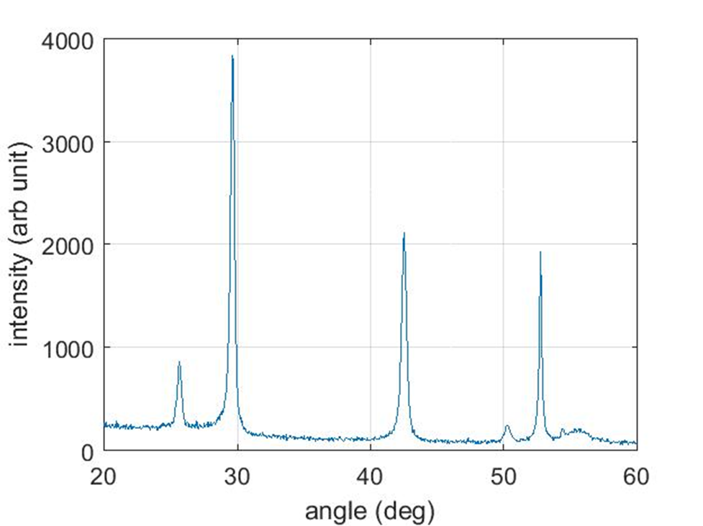
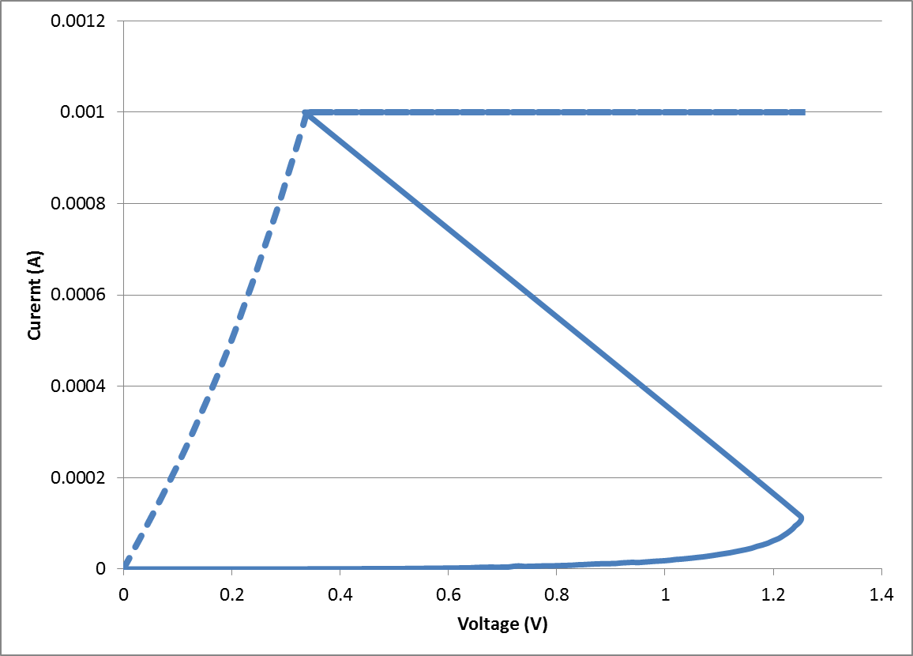
Flexible Memory Characterization
Phase-change memories for flexible and plastic substrates
Ongoing project with PragmatIC Ltd
Exeter and Southampton WAFT groups
WORM and RW formats
GST and novel high-Tc compositions
I-V curves show characteristic threshold switching
XRD data shows high-Tc GST stable to > 300⁰C
GST-225, 15 min 250⁰C anneal

Slide 8

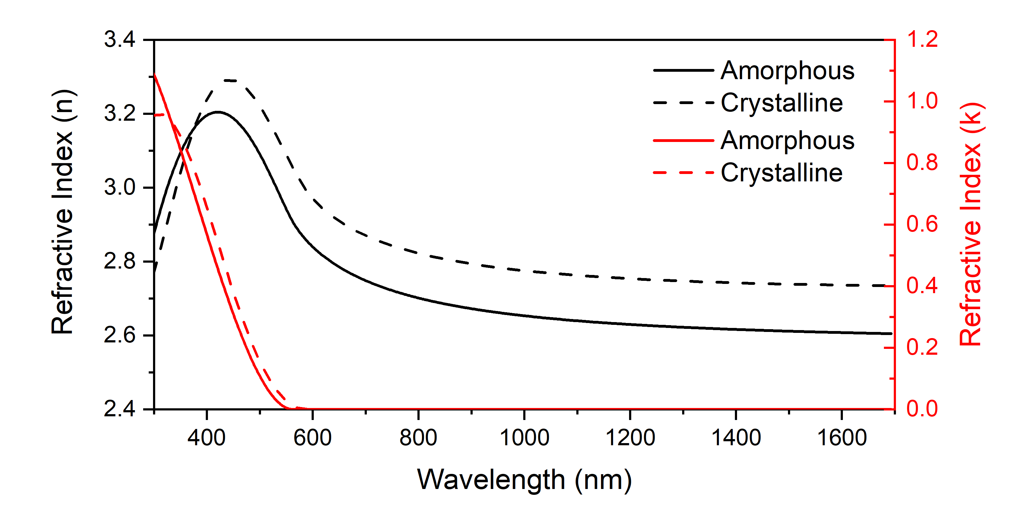
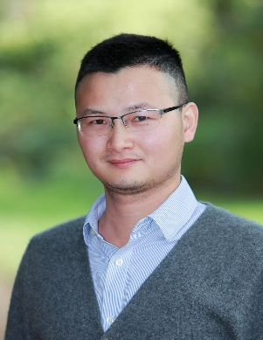
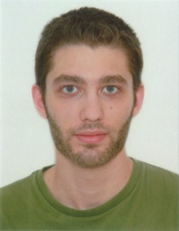
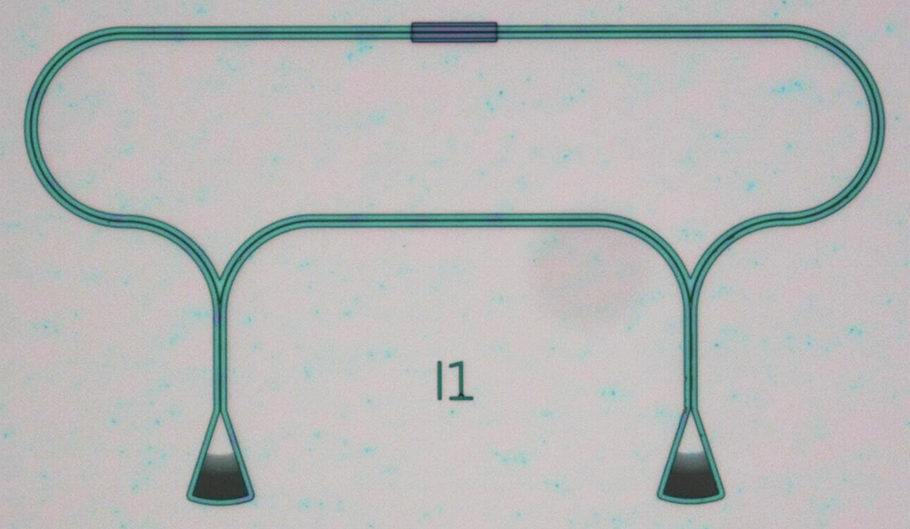
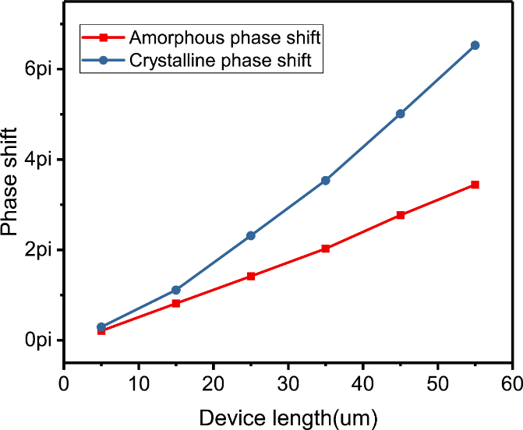
ChAMP
Chalcogenide Advanced Manufacturing Partnership
Flexible funding use
Project: “Optical routing using low-loss phase-change chalcogenides”
Sb₂S₃
Postdoc-led collaborative project – funding of approx. £20k (WAFT-Champ)
Low-loss phase-change material screening for integrated photonics applications
Applications include: machine learning, optical routing, quantum computing, etc.
changing refractive index
very low loss in near-IR
Low loss phase-change material
on photonic waveguide
Nathan Youngblood
University of Oxford
Zengguang Cheng
University of Oxford
Ioannis Zeimpekis
University of Southampton

Slide 9
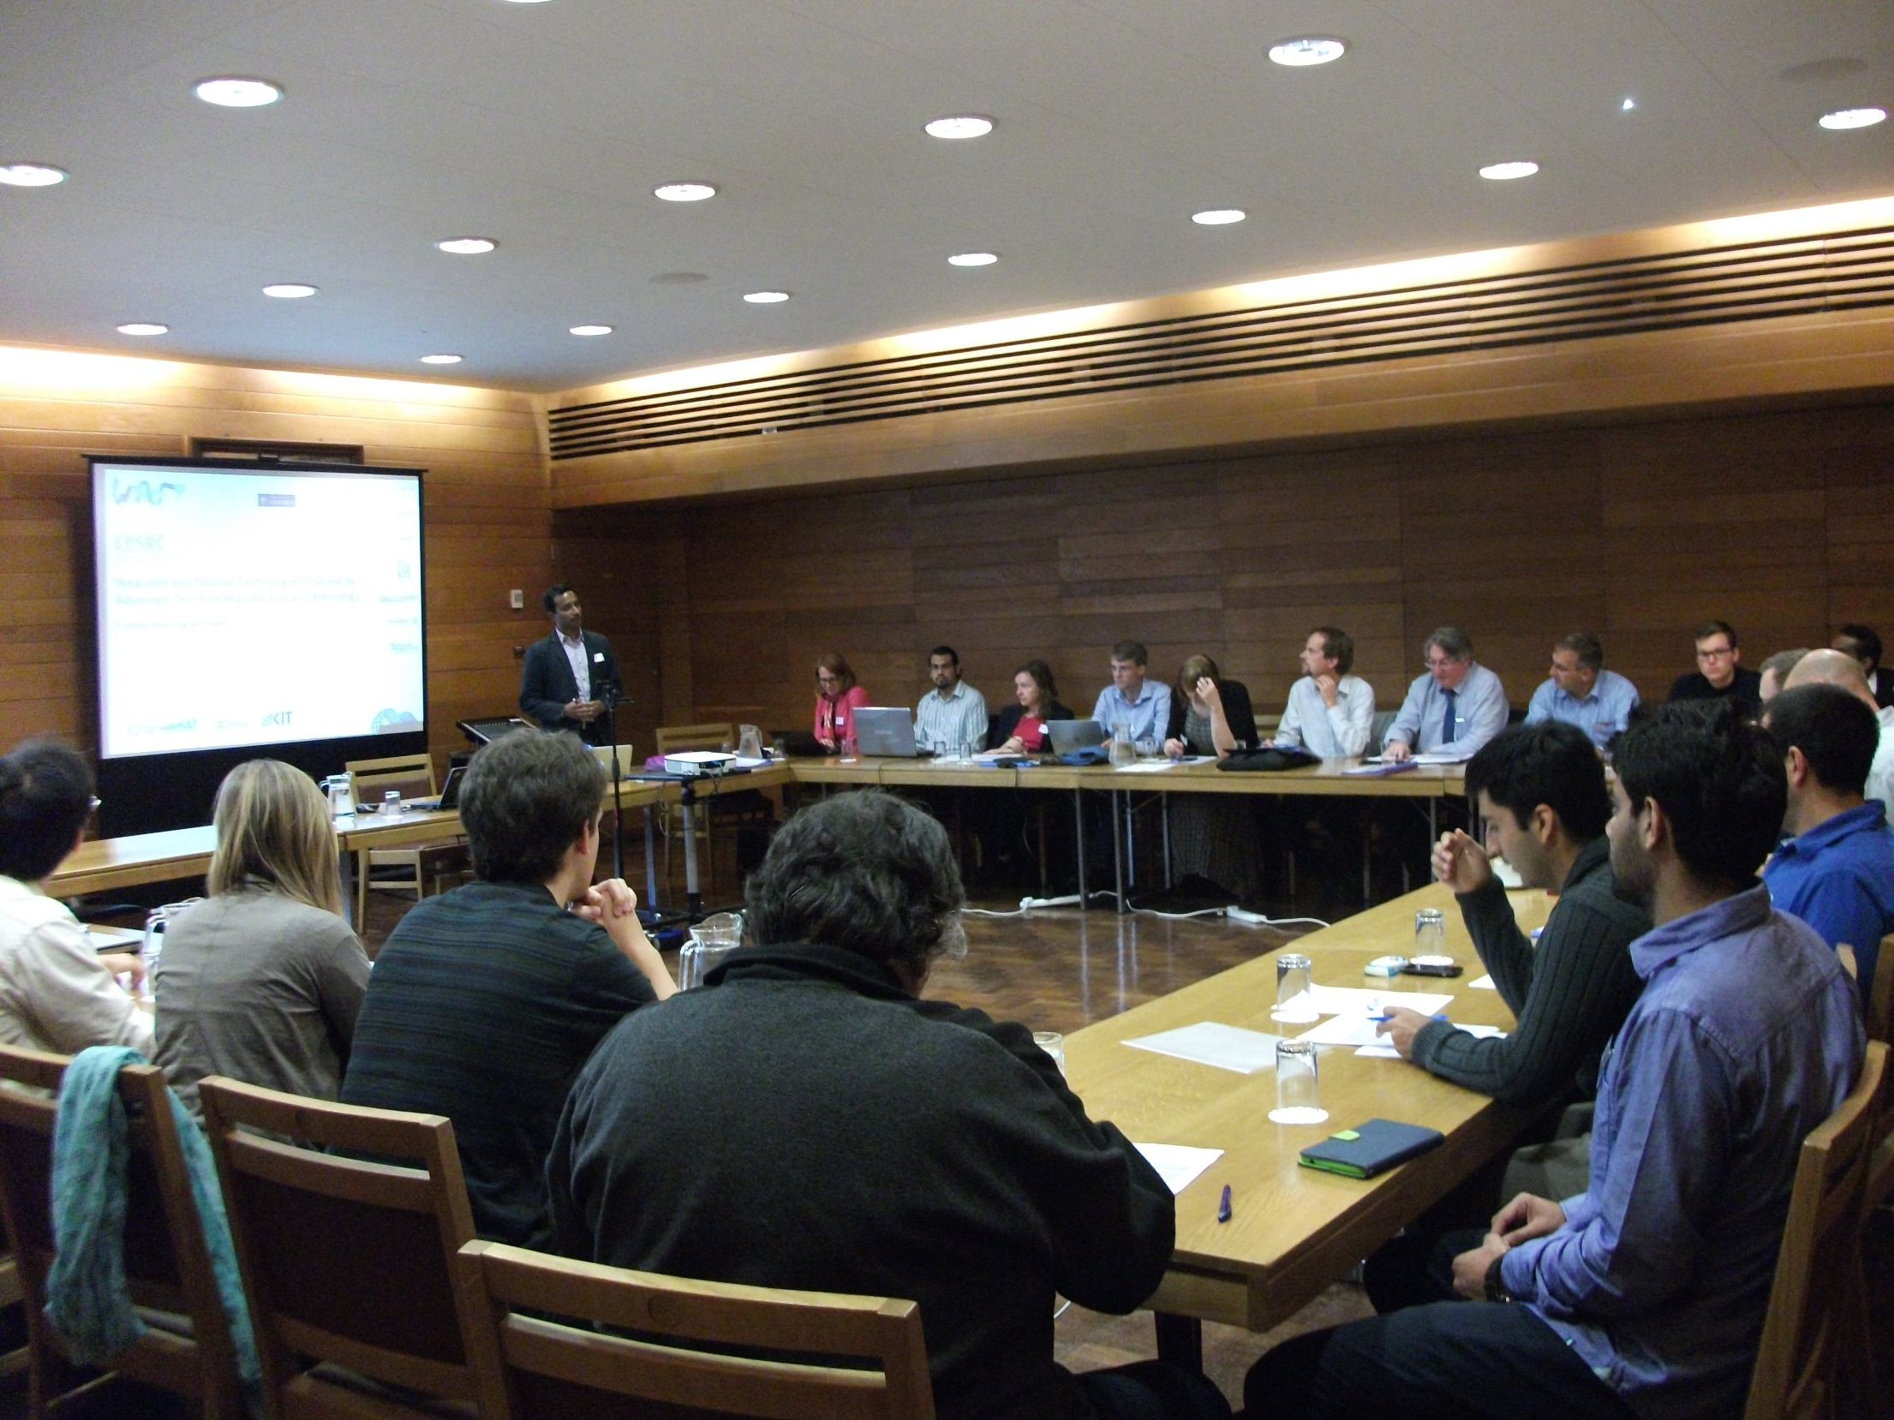
Kick-off meeting 2015

Slide 10
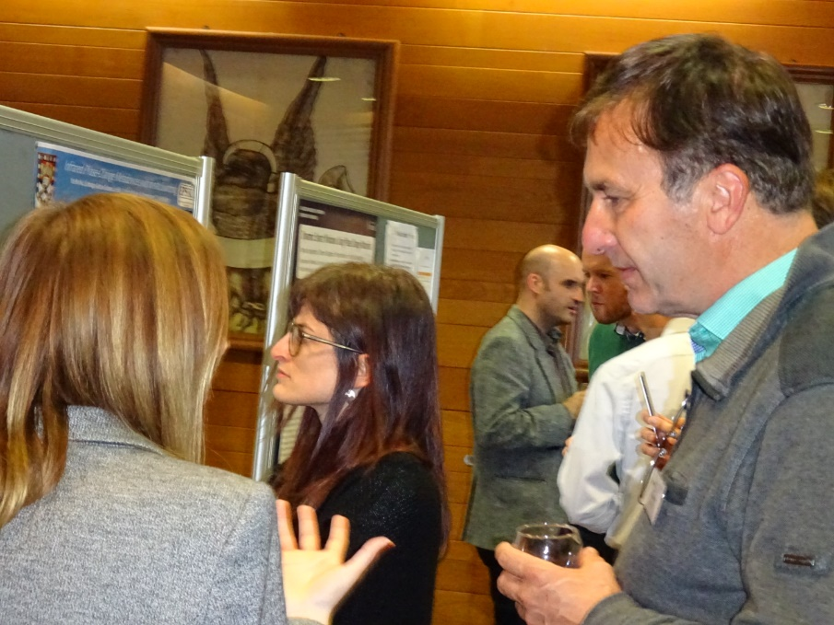
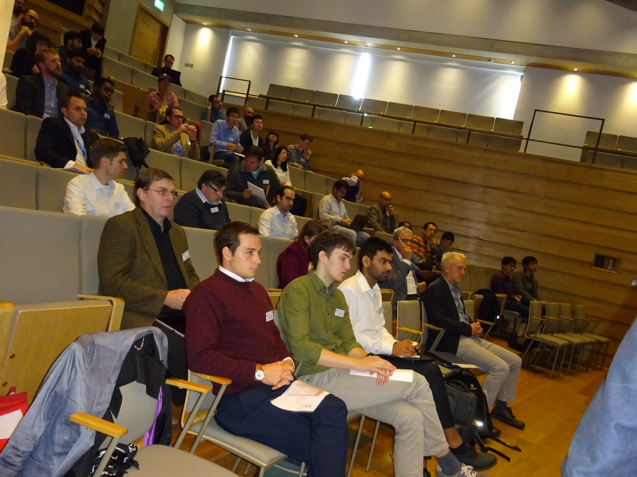
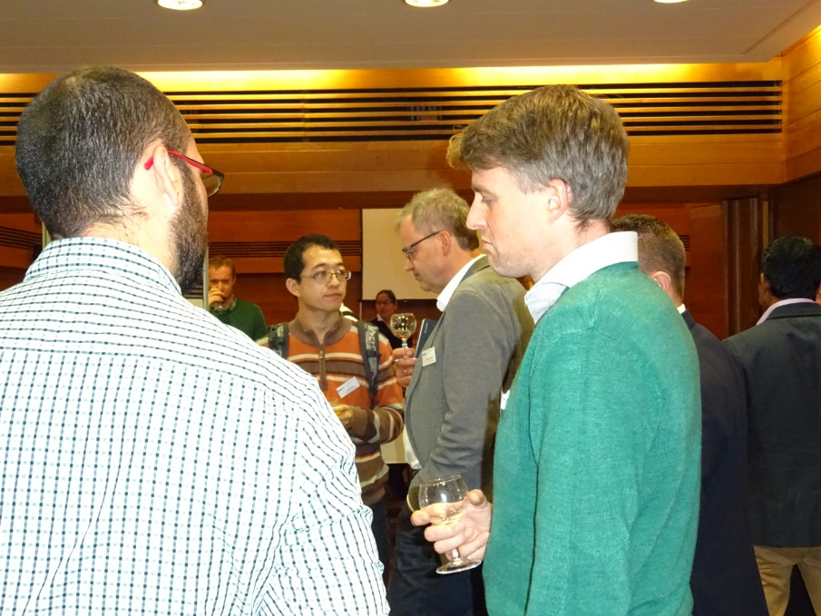
Meeting in 2018

Slide 11
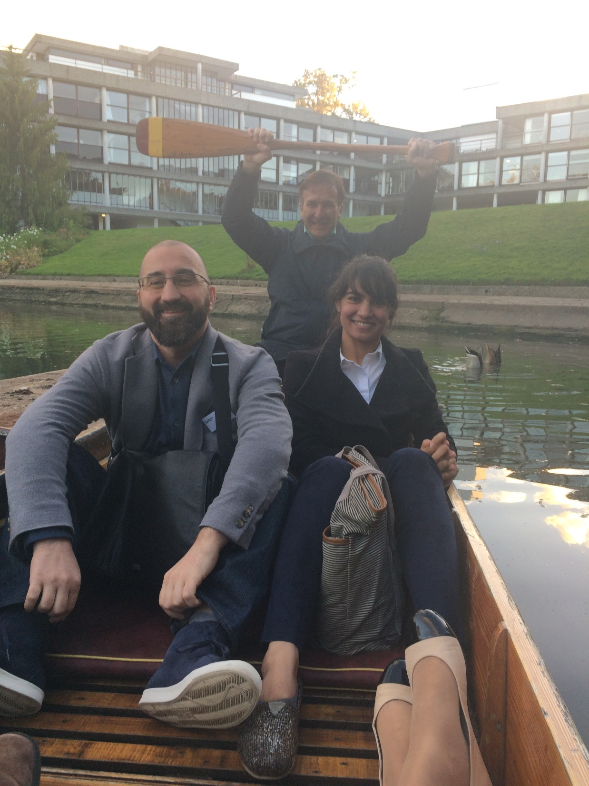
Fun networking
Senior VP at BASF
CEO at PlasmaApp
Postdoc
Ducks in water

Slide 12
Leveraging WAFT
Funding via the Global Challenge Research Fund obtained for projects by Martin Castell to continue work on the flexible sensors.
€5 million EU Project FunCOMP led by David Wright and with Harish Bhaskaran as co-investigator to pursue advanced computing including several EU partners such as IBM, Munster and Thales.
Impact Acceleration Awards to increase impact of research obtained by Moritz Riede and Harish Bhaskaran.

Slide 13




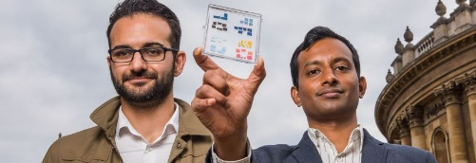
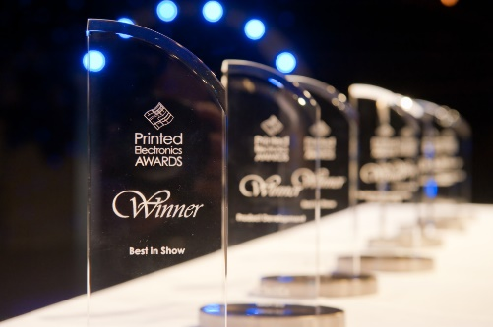






Global attention
Media coverage examples
Breakthroughs in Photonics 2014
Academic R&D Award, IDTechEx Santa Clara 2014
ASME Magazine (USA): Profiled WAFT “Wearing the wire”
P. Hosseini, CD Wright, H. Bhaskaran, Nature 2014.
C. Rios, et al. Nature Photonics 2015.
Z. Cheng, et al. Science Advances 2017.

Slide 14
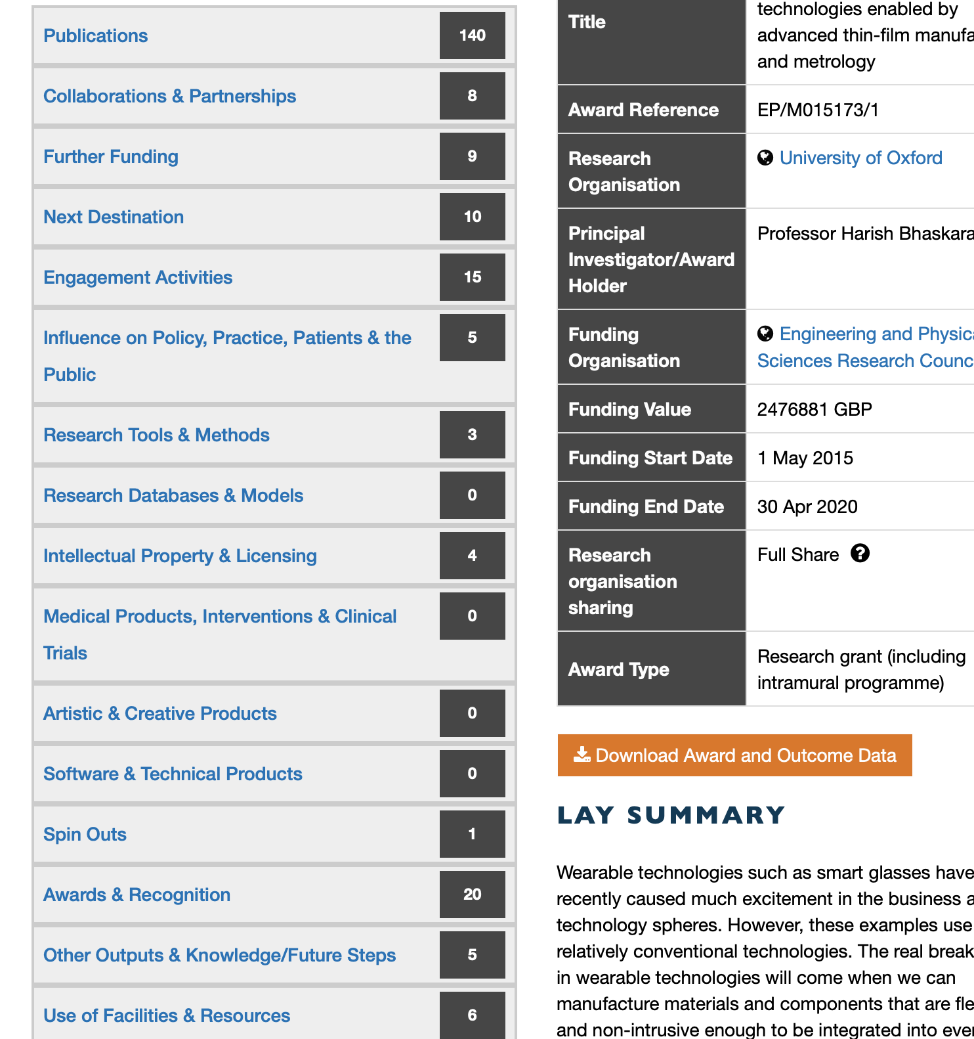
Researchfish outcomes as of 2018 demonstrate phenomenal value for money.

Slide 15

Key areas of achievement
World first areas
Interlocked disparate research areas
Staffing was world-class
Closer cooperation with Industrial Partners
Manufacturing
R2R Processing
Energy Harvesting
2019 Focus:
Demos for industrial partners.
What next? Future planning to maintain momentum
Modelling
Materials
Metrology
Sensors
Displays

